Slide 1






Rest Services
Consuming with JavaScript
Rest Services
SoftUni Team
Technical Trainers
Software University
http://softuni.bg

Slide 2


Table of Contents
RESTful Design
GET Requests
POST Requests
PUT Requests
DELETE Requests

Slide 3
Have a Question?
sli.do #JavaWeb

Slide 4
RESTful Design

Slide 5
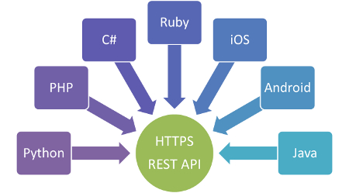
RESTful Design

Slide 6

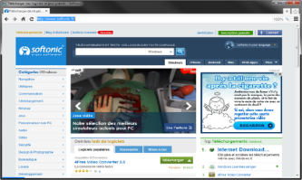




HTTP GET
Used to retrieve data arrays
Web Client
Server
[ {
"id": 32,
"name": “Read Book",
"deadline": 1362268800000, "categoryName": "Work", "enabled": false
}, …
]
GET /items
Response

Slide 7
HTTP GET
Used to retrieve single data entities
Web Client
Server
{
"id": 32,
"name": “Read Book",
"deadline": 1362268800000, "categoryName": "Work", "enabled": false
}
GET /items/1
Response

Slide 8
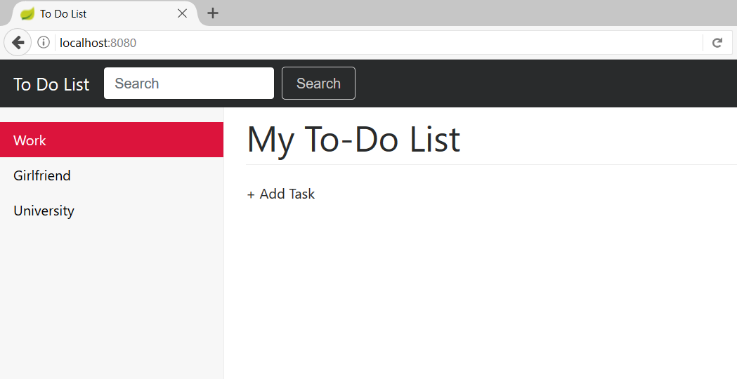
Problem 1
Get Available Categories

Slide 9
Get Available Categories
CategoryController.java
@GetMapping("/categories")
public ResponseEntity<List<CategoryViewModel>> getAllCategories(){
List<CategoryViewModel> categories = this.categoryService.getAllCategories();
return new ResponseEntity(categories, HttpStatus.OK);
}
Returns Categories in JSON

Slide 10
Consume Available Categories
jquery
$.ajax({
type: 'GET',
url: '/categories',
dataType: 'json',
contentType: 'application/json',
success: function (data) {
…
});
GET Request
Request URL
Response Type
Sent Type to Server
Response Data

Slide 11
HTTP POST
Used to save data
Data to Save
Web Client
{
"id": 32,
"name": “Read Book",
"deadline": 1362268800000, "categoryName": "Work", "enabled": false
}
Server
POST /items
Response
OK Response

Slide 12
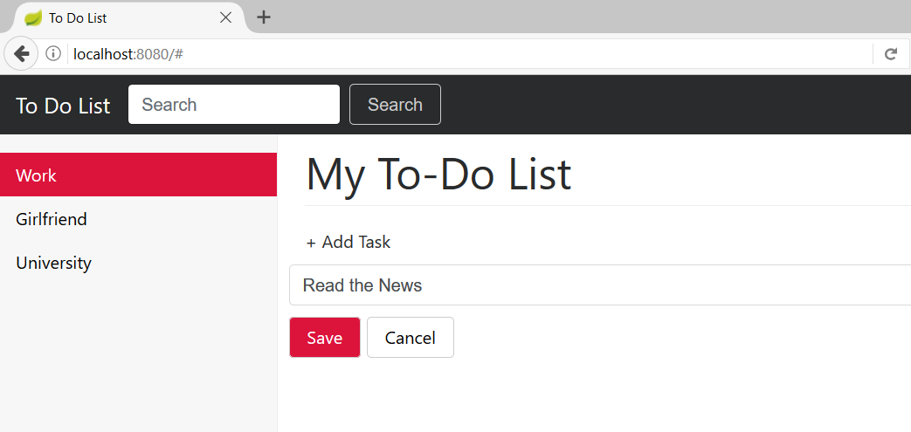
Problem 2
Save Item

Slide 13
Save Item
ItemController.java
@PostMapping(path = "/items")
public ResponseEntity<ToDoItemViewModel> saveItem(@RequestBody ToDoItemBindingModel toDoItemBindingModel) {
ToDoItemViewModel toDoItemViewModel = this.toDoItemService.saveItem(toDoItemBindingModel);
return new ResponseEntity(toDoItemViewModel, HttpStatus.OK);
}
JSON Model
Return Saved Item with ID

Slide 14
Save Item via AJAX
jquery
$.ajax({
type: 'POST',
url: '/items',
data: JSON.stringify(item),
dataType: 'json',
contentType: "application/json",
success: function (toDoItem) {
…
}
}
Item to save
Response Item with Id

Slide 15
HTTP PUT
Used to update data. It is idempotent - can be called many times without different outcomes
Update Item with Id = 1
Data to Update
Web Client
{
"id": 32,
"name": “Read News",
"deadline": 1362268800000, "categoryName": "Work", "enabled": false
}
Server
PUT /items/1
Response
OK Response

Slide 16
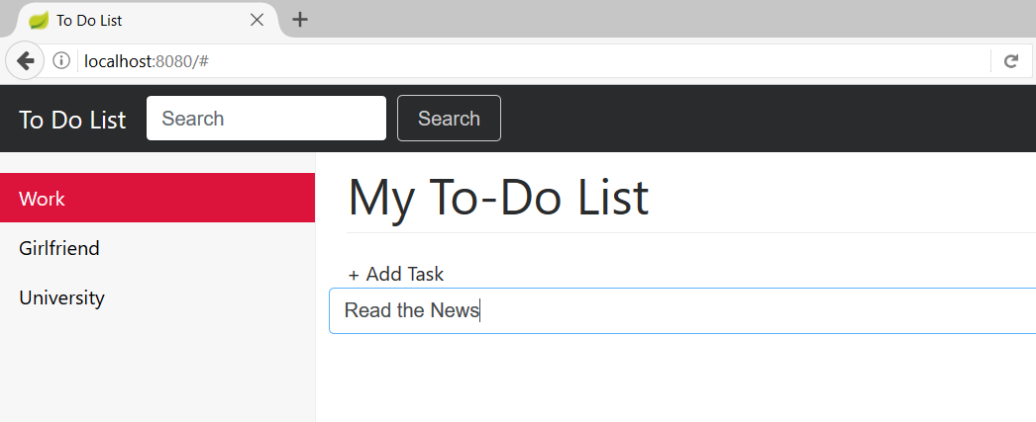
Problem 3
Update Item

Slide 17
Update Item
ItemController.java
@PutMapping(path = "/update/{itemId}")
public ResponseEntity<List<ToDoItemViewModel>> updateItem(@RequestBody ToDoItemBindingModel toDoItemBindingModel, @PathVariable long itemId) {
this.toDoItemService.updateItem(itemId, toDoItemBindingModel);
return new ResponseEntity(HttpStatus.OK);
}
JSON Model
Return OK

Slide 18
Update Item via AJAX
jquery
$.ajax({
type: 'PUT',
url: '/items/update/' + itemId,
data: JSON.stringify(currentItem),
contentType: 'application/json'
})
Dynamic URL

Slide 19
HTTP DELETE
Used to delete data. It is idempotent - can be called many times without different outcomes
Delete Item with Id = 1
Web Client
Server
DELETE /items/delete/1
Response
OK Response

Slide 20
Problem 4
Delete Item

Slide 21
Delete Item
ItemController.java
@DeleteMapping(path = "items/delete/{itemId}")
public ResponseEntity deleteItem(@PathVariable long itemId) {
this.toDoItemService.deleteById(itemId);
return new ResponseEntity(HttpStatus.OK);
}
Return OK

Slide 22
Delete Item via AJAX
jquery
$.ajax({
type: 'DELETE',
url: '/items/delete/' + id,
contentType: 'application/json'
})
Dynamic URL

Slide 23

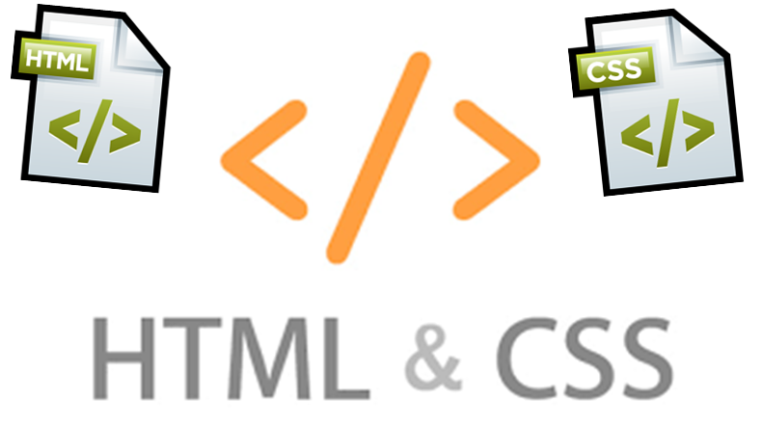
Summary
RESTful design - one way of providing interoperability between computer systems on the Internet

Slide 24









Web Development Basics – Course Overview
https://softuni.bg/courses/

Slide 25
License
This course (slides, examples, demos, videos, homework, etc.) is licensed under the "Creative Commons Attribution-NonCommercial-ShareAlike 4.0 International" license

Slide 26






Free Trainings @ Software University
Software University Foundation – softuni.org
Software University – High-Quality Education, Profession and Job for Software Developers
softuni.bg
Software University @ Facebook
facebook.com/SoftwareUniversity
Software University @ YouTube
youtube.com/SoftwareUniversity
Software University Forums – forum.softuni.bg

